Slide 1
GAN with Nerf
Wen Liu
2020/12/11

Slide 2
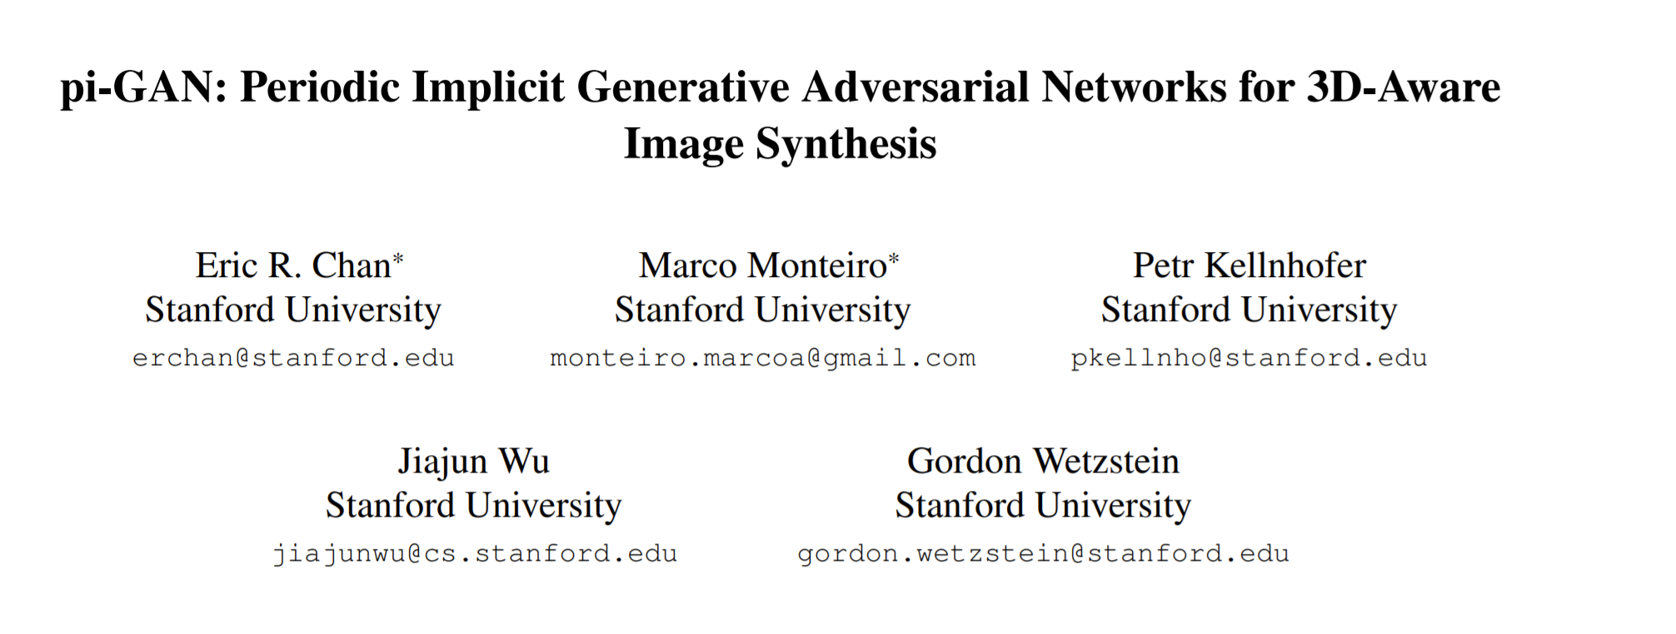
http://xxx.itp.ac.cn/pdf/2012.00926.pdf

Slide 3
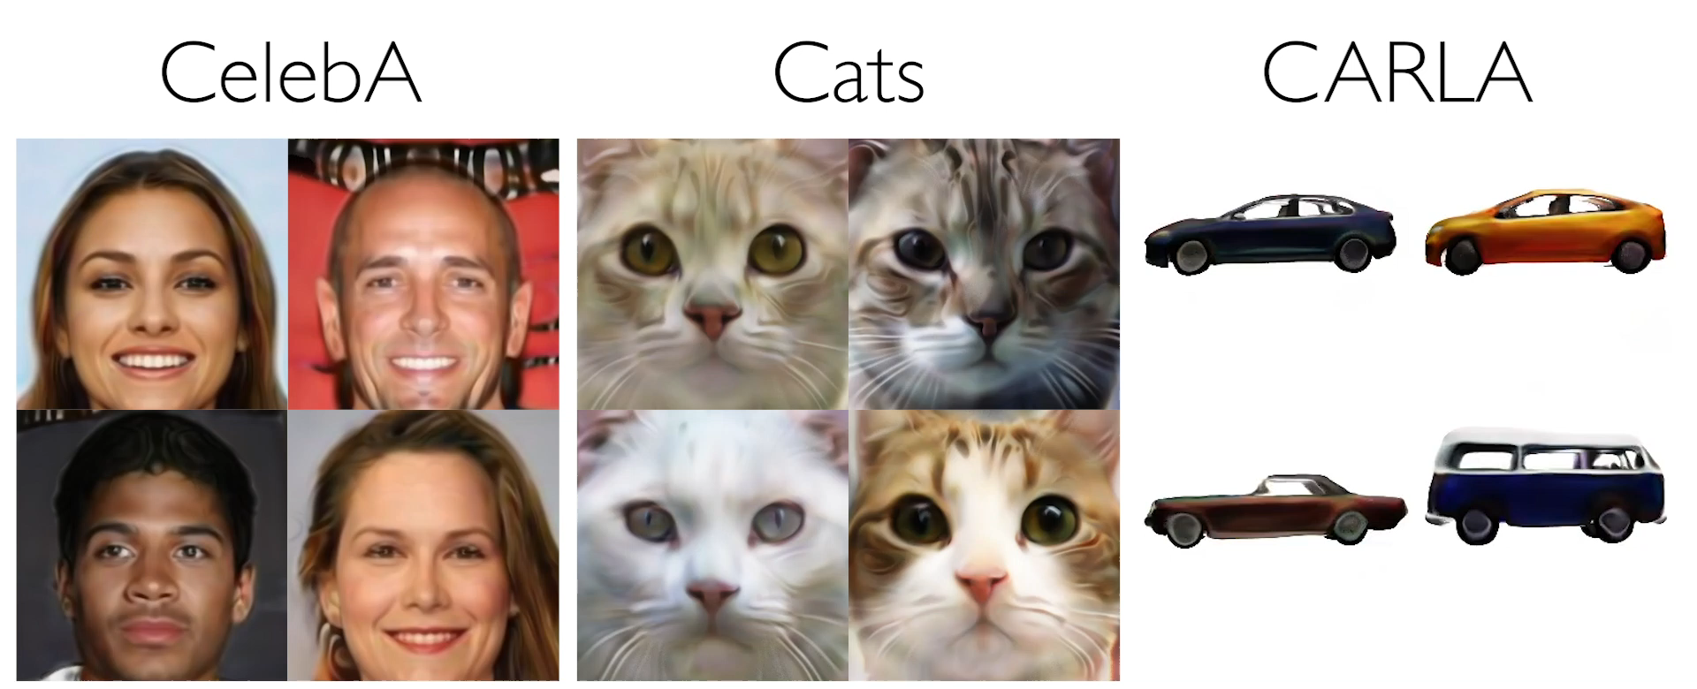
Task
Generate images with 3D-Aware View Synthesis

Slide 4
Challenges
Lack of photorealistic 3D data;
Learn 3D representations unsupervised from 2D images

Slide 5
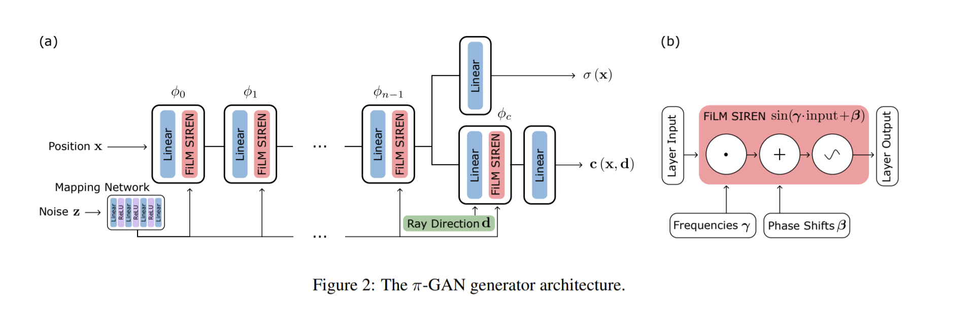
Nerf-based Generator

Slide 6
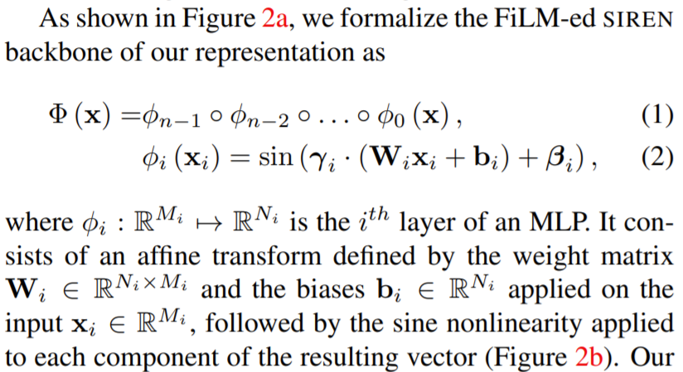
Nerf-based Generator

Slide 7
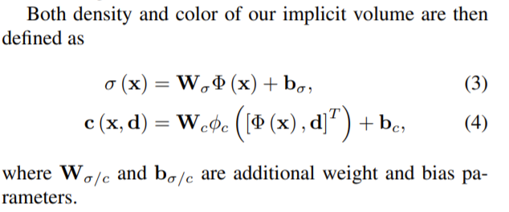
Nerf-based Generator

Slide 8
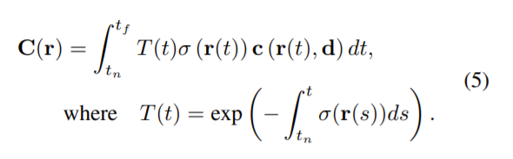
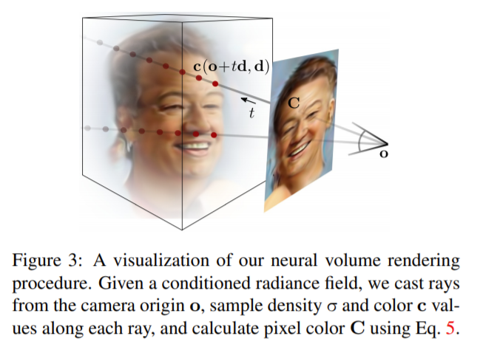
Nerf-based Generator

Slide 9
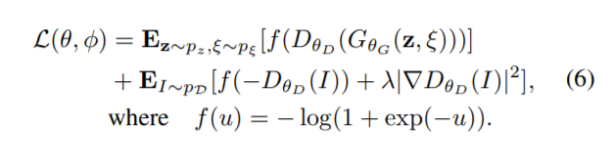
Progressive Discriminator

Slide 10
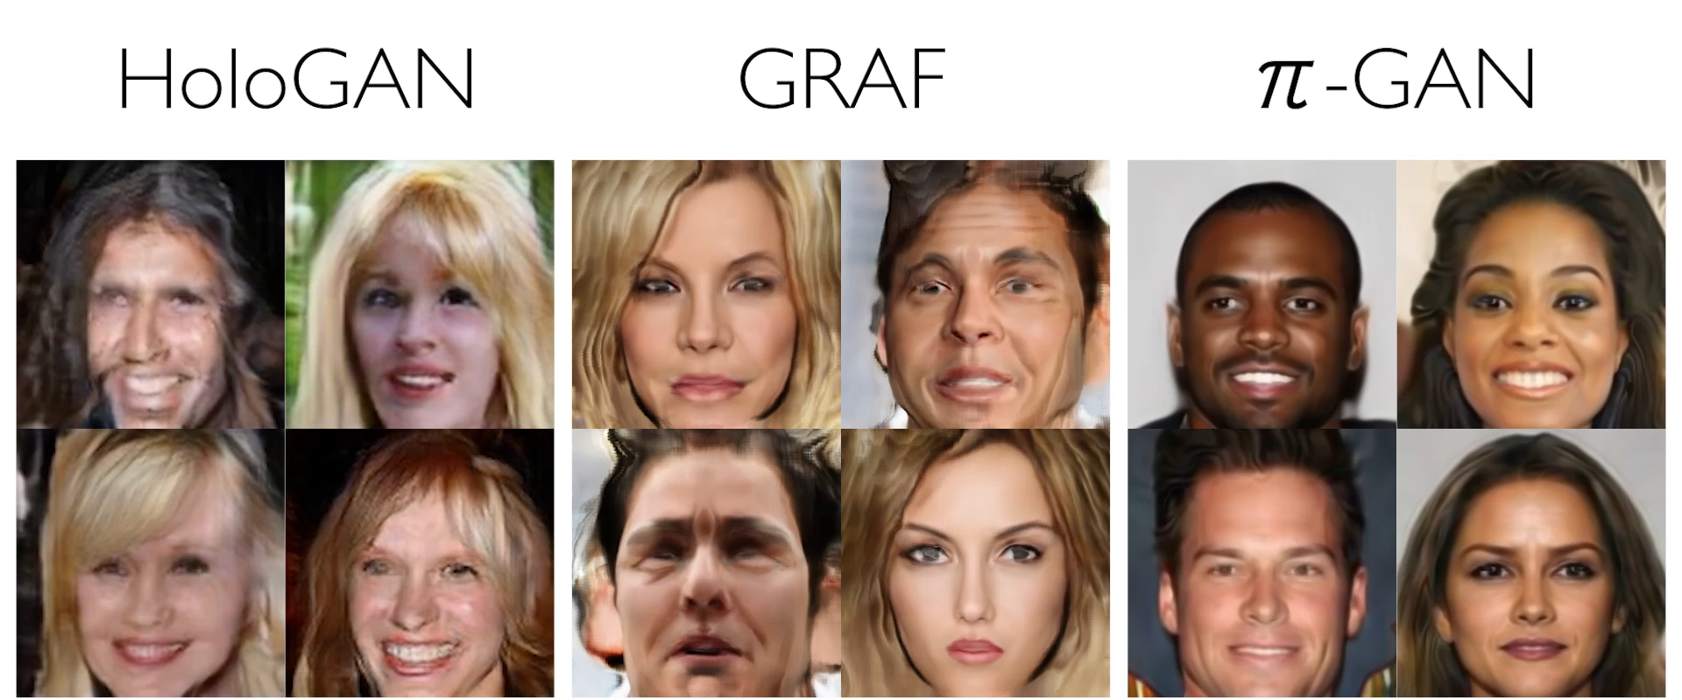
Comparison

Slide 11
More Results
https://marcoamonteiro.github.io/pi-GAN-website/

